Slide 1
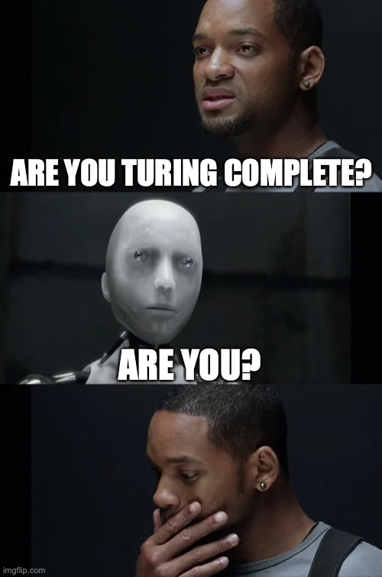
D5: Formal Languages, DFA, and Turing Machines
Sec 16: Fr 12:30pm-1:30pm FXB 1024
IA: Nick Frieler
Slide deck available at course drive/Discussions/Slides/Nick

Slide 2
Agenda
Formal languages
  Many definitions
(Deterministic) finite automata
  Definition
Turing machines
  Definition
  Church-Turing thesis

Slide 3
Formal Languages

Slide 4
Time to get try-lingual
An alphabet is a nonempty, finite set of symbols
  a, b, c, d, …, z
  +, -, x, /, 0, 1, 2, …, 9
A string over an alphabet Σ is a finite, ordered sequence of symbols from Σ
  If Σ = {a, …, z}, then “hello” is a string over Σ
  If Σ = {+, -, x, /, 0, …, 9}, then “376+281+370” is a string over Σ
  Σ* is the set of all strings over Σ
A language L over an alphabet Σ is a subset of Σ*
  The set of all decimal representations of even numbers is a language over {0, …, 9}

Slide 5
(Deterministic) Finite Automata

Slide 6
Desperately Following Arrows
A deterministic finite automaton (DFA) is a 5-tuple M = (Σ, Q, q₀, F, 𝛿)
  Σ is the input alphabet
  Q is the finite set of the automaton’s states
  q₀ ∈ Q is the initial state
  F ⊆ Q is the subset of accepting states
  𝛿 is the transition function, it maps from Q x Σ→ Q
    Because a DFA is deterministic, 𝛿 must be a function (exactly one output for each input)
The language L of a finite automaton M is the set of strings it accepts. We also say
  M decides L if and only if M accepts every string in L and reject every other string

Slide 7
Turing Machines

Slide 8
Please just one more definition
A Turing machine is a 7-tuple M = (Σ, Γ, Q, q_{start}, q_{acc}, q_{rej}, 𝛿)
  Σ is the input alphabet
  Γ is the tape alphabet (contains Σ and a blank symbol ⟂)
  Q is the finite set of states
  q_{start} is the initial state
  q_{acc}, q_{rej} ∈ Q are the accept state and reject state, respectively (must be distinct)
    We say F = {q_{acc}, q_{rej}} is the set of final states
  𝛿 is the transition function

Slide 9
Ok but what does a TM do?
The input is given on the TM's tape
The TM head points to the first cell of the tape, starting in state q_{start}
The TM repeatedly applies its transition function 𝛿 until it reaches one of q_{acc} or q_{rej}
  If this never happens, the TM runs forever
Because a TM M might not halt on an input x, we have three cases:
  M(x) eventually accepts
  M(x) eventually rejects
  M(x) runs forever (or “loops”)

Slide 10
Ok but what does a TM do?
The language L(M) of a Turing machine M is the set of strings M accepts
A TM decides a language L if
  M accepts every string in L
  M rejects every string not in L
  NO LOOPING
A TM recognizes a language L if
  M accepts every string in L
  M rejects or loops on every string not in L

Slide 11
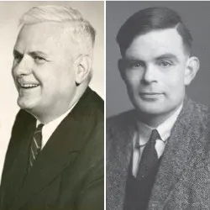
Church-Turing thesis
A function can be computed by an “effective’ or “mechanical” procedure (i.e., an algorithm) if and only if it can be computed by some Turing machine
  This is not a statement that we can prove!
  This is essentially a definition of what computation is

Slide 12
Any questions before discussion problems?

Slide 13
Discussion Problems

Slide 14
Q1: Drawing Forty Arrows
True or False: there is a DFA that decides the following language:
L = {x: x is a binary string of length 4 that starts with two 1s}
Justify your answer

Slide 15
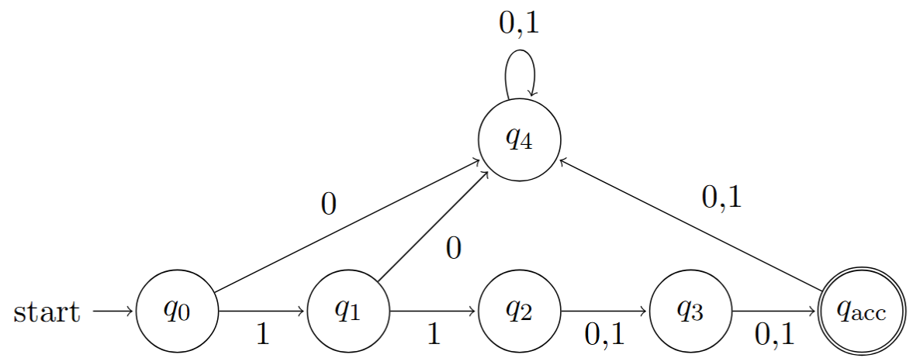
Q1: Drawing Forty Arrows
SOLUTION
True or False: there is a DFA that decides the following language:
L = {x: x is a binary string of length 4 that starts with two 1s}
Justify your answer
True

Slide 16
Q2: Is that a palindrome?
True or False: there is a DFA that decides the following language:
L = {x: x is palindrome} where the language Σ has at least 2 elements
Justify your answer

Slide 17
Q2: Is that a palindrome?
SOLUTION
True or False: there is a DFA that decides the following language:
L = {x: x is palindrome} where the language Σ has at least 2 elements
Justify your answer
False… but why?
Suppose there is a DFA M (with s states) that decides L
Let x and y be two (distinct) symbols in Σ
Consider the states M is in after processing the strings x¹, x², …, x^{s}, x^{s+1}
  By the pigeonhole principle, M must be in the same state after processing at least two of these strings, say x^{i} and x^{j} where i ≠ j
What happens when we run M on the strings x^{i}yx^{i} and x^{j}yx^{i}?
  It has to either reject both or accept both
  CONTRADICTION → no DFA decides L

Slide 18
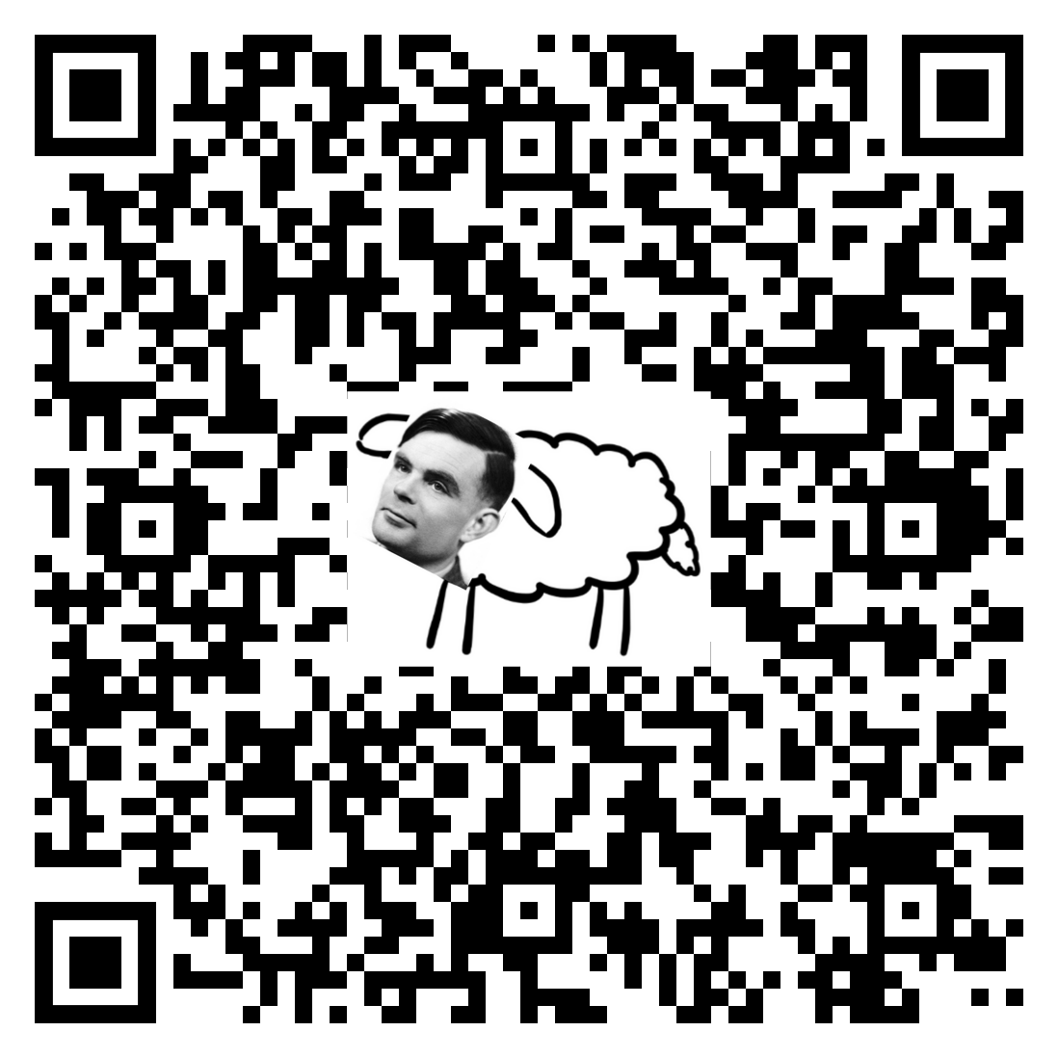
Attendance
https://tinyurl.com/2za4dcmm

Slide 19
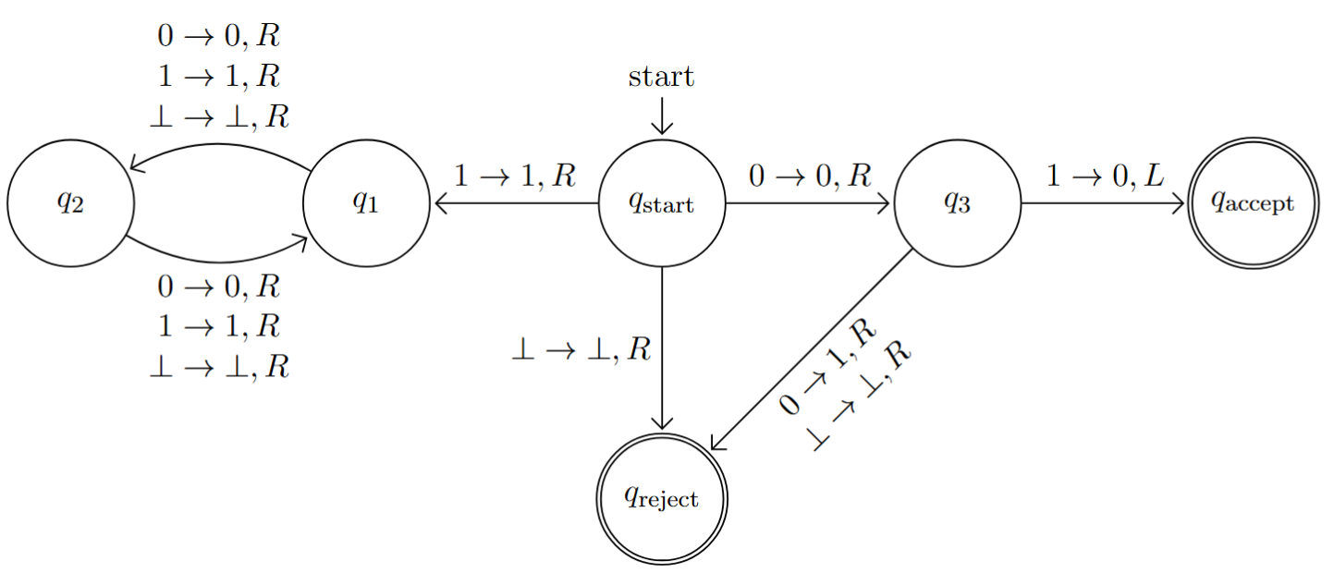
Q3: Decisions decisions
What language does the following Turing machine accept, if any?

Slide 20
Q3: Decisions decisions
SOLUTION
What language does the following Turing machine decide, if any?
This Turing machine does not decide any language! For example, it loops on input “11”

Slide 21
Q4: Pattern recognition
What inputs does this Turing machine (same as last question) accept? reject? loop on?

Slide 22
Q4: Pattern recognition
SOLUTION
What inputs does this Turing machine (same as last question) accept? reject? loop on?
Accept:
  01(0|1)*
Reject:
  𝜀|(00(0|1)*)|0
Loop:
  1(0|1)*
Does this Turing machine recognize a language?
Of course! Every Turing machine recognizes a language

Slide 23
Q5: Decidedly decidable
Let A and B be two decidable languages. Given access to a Turing machine M_{A} that decides A and a Turing machine M_{B} that decides B, what languages based on A and B can you come up with that are also decidable?

Slide 24
Q5: Decidedly decidable
SOLUTION
Let A and B be two decidable languages. Given access to a Turing machine M_{A} that decides A and a Turing machine M_{B} that decides B, what languages based on A and B can you come up with that are also decidable?
A ∪ B
  x ∈ A ∪ B ⇔ M_{A}(x) accepts OR M_{B}(x) accepts
A \ B
  x ∈ A \ B ⇔ M_{A}(x) accepts AND M_{B}(x) rejects
B \ A
  x ∈ B \ A ⇔ M_{A}(x) rejects AND M_{B}(x) accepts
A ∩ B
  x ∈ A ∩ B ⇔ M_{A}(x) accepts AND M_{B}(x) accepts
We can also decide the complements of these languages

